Slide 1





Azure & DevOps Study Group
Free Live Webinar
AZ-900: Microsoft Azure Fundamentals
Module 1: Introduction to Azure Concepts and Core Azure Services
25/10/2021
07:00 PM UK

Slide 2
Module 1:
Introduction to Azure Concepts and Core Azure Services

Slide 3
Module 1: Intro
Introduction and Module Overview

Slide 4
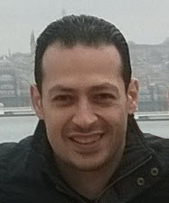





About The Presenter
Mohamed Radwan
Principal DevOps Consultant/ NTT DATA UK. Over 19 years of experience
Microsoft Azure DevOps & GitHub MVP for 10 years
Helped more than 50 enterprise companies some of them from the Fortune 500
Presented hundreds of sessions in many conferences & events around the globe
Developed many tools and frameworks on GitHub and Azure DevOps Marketplace
mohamedradwan.com
Notes:
How Cloud Can Help DevOps Transformation

Slide 5


Module 1: Overview
This lesson will cover
Speakers and Lessons of This Module
Lessons and Allocated Time of This Module
Overview About Each Lessons in This Module
Notes:
How Cloud Can Help DevOps Transformation

Slide 6
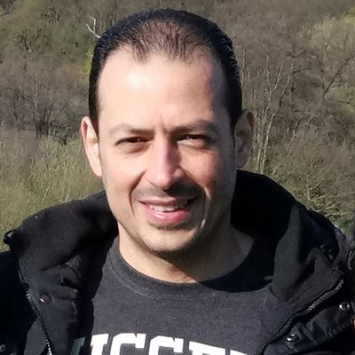

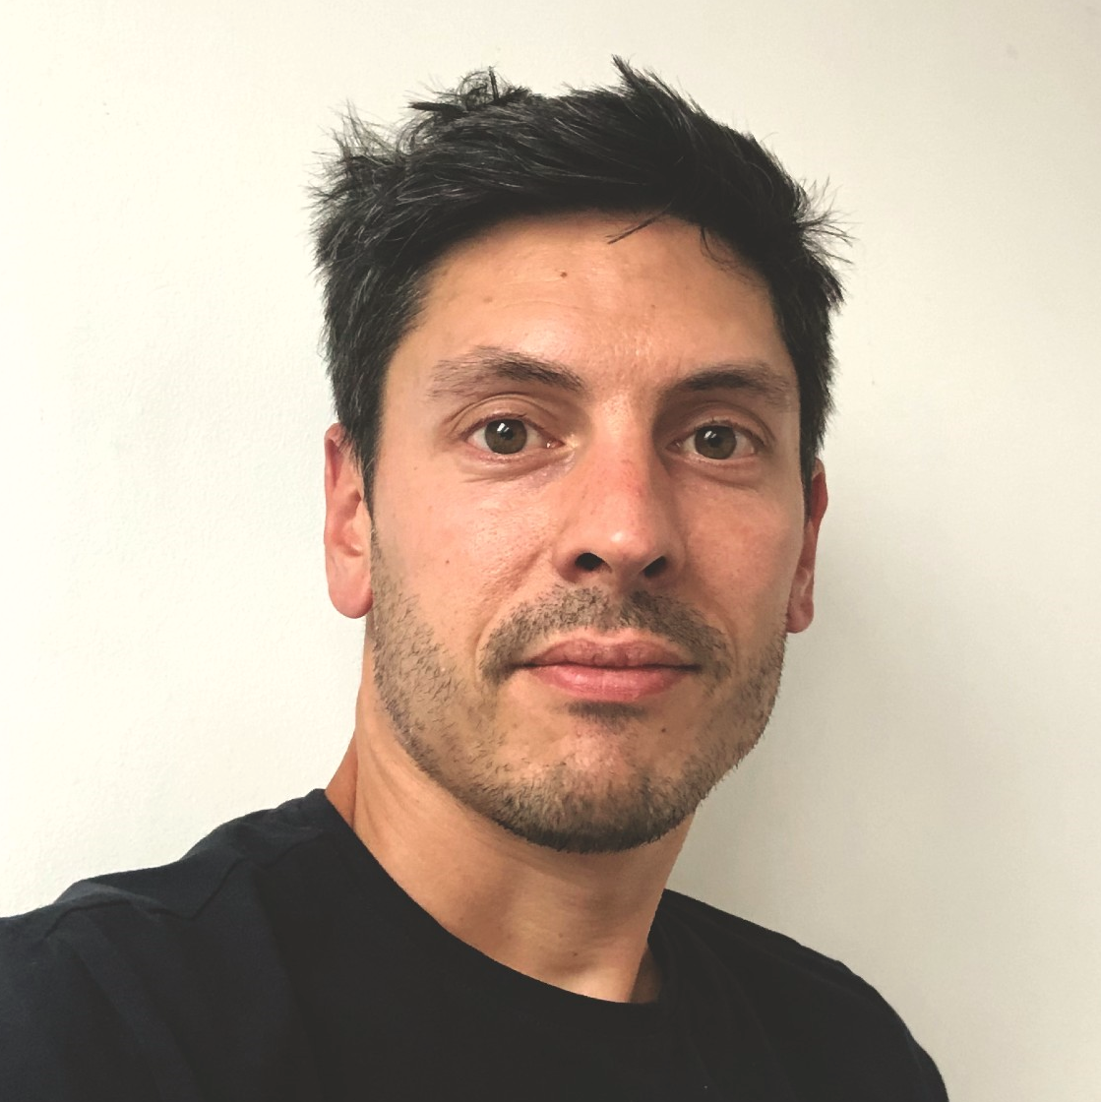
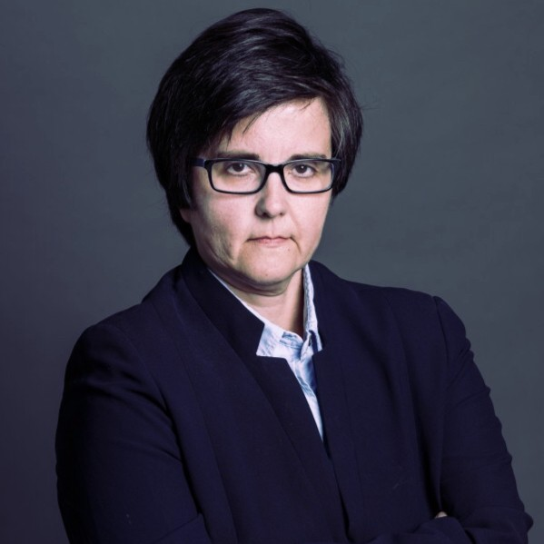
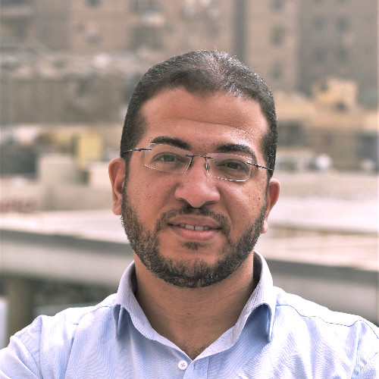


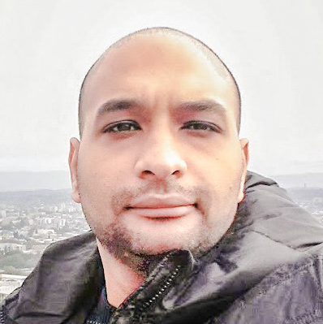
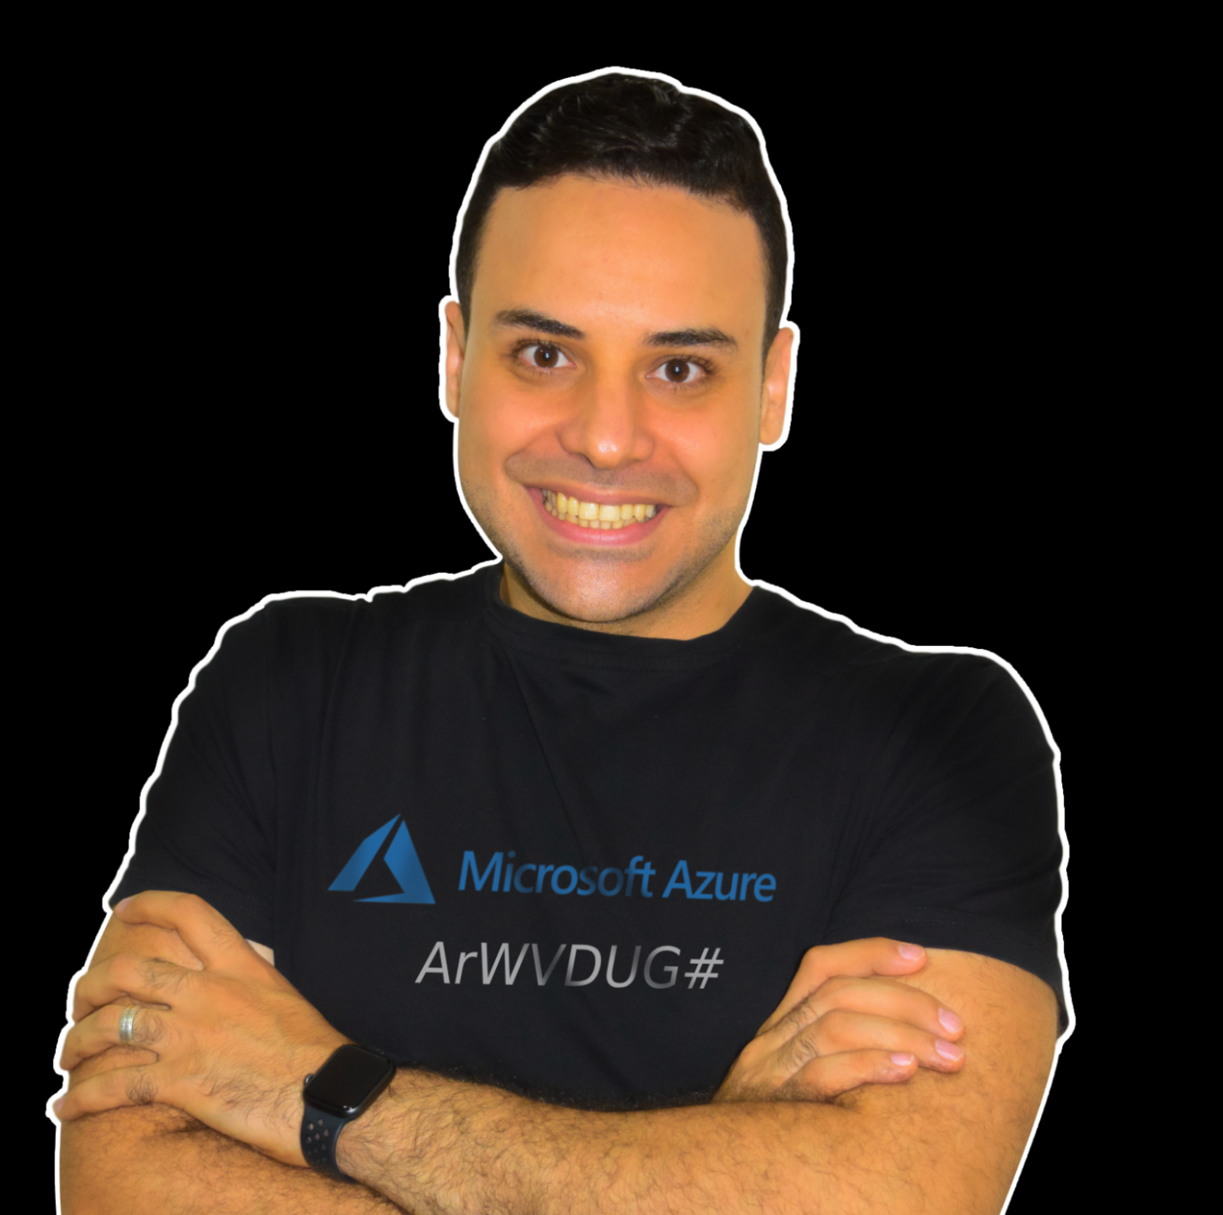
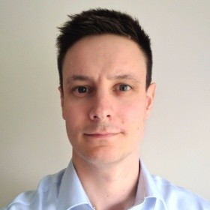
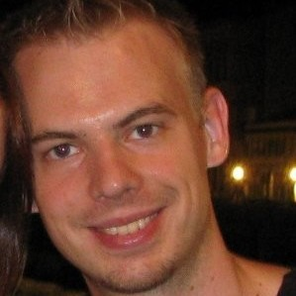


Module 1: Speakers and Lessons
Mohamed Radwan
Principal DevOps
NTT DATA UK
UK/London
Aaron Hughes Senior Consultant
Hitachi Solutions
UK/Plymouth
Sebastien Boinot
Principal DevOps
NTT DATA UK
UK/London
Paloma Giraudo Infra&Security Manager
Secuirtypyme
Spain/Madrid
Muhammad Gouda Senior App Dev Consultant
Microsoft
Egypt/Cairo
(0) Introduction and Module Overview
(1) --
(2) Understanding cloud fundamental concepts
(3) --
(4) --
Mohammed Adel Senior Cloud Engineer
MAF Retail
UAE/Dubai
Mahmoud A. ATALLAH Sr. Cloud Architect
Bespin Global MEA UAE/Abu Dhabi
Phil Cole
D-365/Power Platform
DXC Technology
UK/London
Mario Dietner
Senior Technologist and AI
Trivadis AG
Switzerland/Zürich
(5) --
(6) --
(7) --
(8) --

Slide 7
Module 1: Agenda and Allocated Time
Lesson No | Speaker Name | Lesson Title | Allocated Time (UK)
0 | Mohamed Radwan | Introduction and Module Overview | 07:00 – 07:05 PM
1 | Aaron Hughes |  | 07:05 – 07:35 PM
2 | Sebastien Boinot | Understanding cloud fundamental concepts | 07:35 – 07:55 PM
3 | Paloma Giraudo |  | 07:55 – 08:15 PM
4 | Muhammad Gouda |  | 08:15 – 08:35 PM
Break |  |  | 08:35 – 8:45 PM
5 | Mohammed Adel |  | 08:45 – 09:10 PM
6 | Mahmoud A. ATALLAH |  | 9:10 – 09:30 PM
7 | Phil Cole |  | 09:30 – 09:50 PM
8 | Mario Dietner |  | 09:50 – 10:10 PM
Notes:
How Cloud Can Help DevOps Transformation

Slide 8

Summary
This lesson has covered
Speakers and Lessons of This Module
Lessons and Allocated Time of This Module
Overview About Each Lessons in This Module
Next Lesson:
(1) -----
Notes:
How Cloud Can Help DevOps Transformation

